Slide 1
3
Structured Program Development in C

Slide 2
Let’s all move one place on.
  Lewis Carroll
The wheel is come full circle.
  William Shakespeare
How many apples fell on Newton’s head before
he took the hint!
  Robert Frost
All the evolution we know of proceeds from the vague to the definite.
  Charles Sanders Peirce

Slide 3
OBJECTIVES
In this chapter you will learn:
Basic problem-solving techniques.
To develop algorithms through the process of
top-down, stepwise refinement.
To use the if selection statement and if...else selection statement to select actions.
To use the while repetition statement to execute statements in a program repeatedly.
Counter-controlled repetition and sentinel-controlled repetition.
Structured programming.
The increment, decrement and assignment operators.

Slide 4
3.1 Introduction
3.2 Algorithms
3.3 Pseudocode
3.4 Control Structures
3.5 The if Selection Statement
3.6 The if...else Selection Statement
3.7 The while Repetition Statement

Slide 5
3.8 Formulating Algorithms: Case Study 1
(Counter-Controlled Repetition)
3.9 Formulating Algorithms with Top-Down, Stepwise Refinement: Case Study 2 (Sentinel-Controlled Repetition)
3.10 Formulating Algorithms with Top-Down, Stepwise Refinement: Case Study 3 (Nested Control Structures)
3.11 Assignment Operators
3.12 Increment and Decrement Operators

Slide 6
3.1 Introduction
Before writing a program:
  Have a thorough understanding of the problem
  Carefully plan an approach for solving it
While writing a program:
  Know what “building blocks” are available
  Use good programming principles

Slide 7
3.2 Algorithms
Computing problems
  All can be solved by executing a series of actions in a specific order
Algorithm: procedure in terms of
  Actions to be executed
  The order in which these actions are to be executed
Program control
  Specify order in which statements are to be executed

Slide 8
3.3 Pseudocode
Pseudocode
  Artificial, informal language that helps us develop algorithms
  Similar to everyday English
  Not actually executed on computers
  Helps us “think out” a program before writing it
    Easy to convert into a corresponding C++ program
    Consists only of executable statements

Slide 9
3.4 Control Structures
Sequential execution
  Statements executed one after the other in the order written
Transfer of control
  When the next statement executed is not the next one in sequence
  Overuse of goto statements led to many problems
Bohm and Jacopini
  All programs written in terms of 3 control structures
    Sequence structures: Built into C. Programs executed sequentially by default
    Selection structures: C has three types: if, if…else, and switch
    Repetition structures: C has three types: while, do…while and for

Slide 10
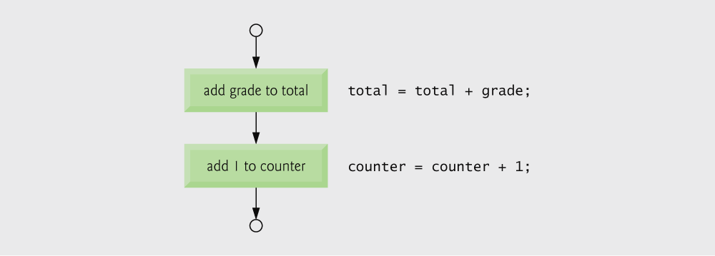
Fig. 3.1 | Flowcharting C’s sequence structure.

Slide 11
3.4 Control Structures
Flowchart
  Graphical representation of an algorithm
  Drawn using certain special-purpose symbols connected by arrows called flowlines
  Rectangle symbol (action symbol):
    Indicates any type of action
  Oval symbol:
    Indicates the beginning or end of a program or a section of code
Single-entry/single-exit control structures
  Connect exit point of one control structure to entry point of the next (control-structure stacking)
  Makes programs easy to build

Slide 12
3.5 The if selection statement
Selection structure:
  Used to choose among alternative courses of action
  Pseudocode:
    If student’s grade is greater than or equal to 60
    Print “Passed”
If condition true
  Print statement executed and program goes on to next statement
  If false, print statement is ignored and the program goes onto the next statement
  Indenting makes programs easier to read
    C ignores whitespace characters

Slide 13
Good Programming Practice 3.1
Consistently applying responsible indentation conventions greatly improves program readability. We suggest a fixed-size tab of about 1/4 inch or three blanks per indent.
In this book, we use three blanks per indent.

Slide 14
Good Programming Practice 3.2
Pseudocode is often used to “think out” a program during the program design process. Then the pseudocode program is converted to C.

Slide 15
3.5 The if selection statement
Pseudocode statement in C:
    if ( grade >= 60 )
    printf( "Passed\n" );
  C code corresponds closely to the pseudocode
Diamond symbol (decision symbol)
  Indicates decision is to be made
  Contains an expression that can be true or false
  Test the condition, follow appropriate path

Slide 16

Fig. 3.2 | Flowcharting the single-selection if statement.

Slide 17
3.6 The if…else selection statement
if
  Only performs an action if the condition is true
if…else
  Specifies an action to be performed both when the condition is true and when it is false
Psuedocode:
    If student’s grade is greater than or equal to 60
    Print “Passed”
    else
    Print “Failed”
  Note spacing/indentation conventions

Slide 18
Good Programming Practice 3.3
Indent both body statements of an if...else statement.

Slide 19
Good Programming Practice 3.4
If there are several levels of indentation, each level should be indented the same additional amount of space.

Slide 20
3.6 The if…else selection statement
C code:
    if ( grade >= 60 )
    printf( "Passed\n");
    else
    printf( "Failed\n");
Ternary conditional operator (?:)
  Takes three arguments (condition, value if true, value if false)
  Our pseudocode could be written:
    printf( "%s\n", grade >= 60 ? "Passed" : "Failed" );
  Or it could have been written:
    grade >= 60 ? printf( “Passed\n” ) : printf( “Failed\n” );

Slide 21
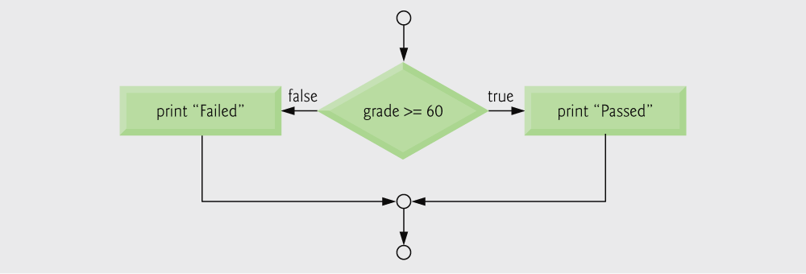
Fig. 3.3 | Flowcharting the double-selection if...else statement.

Slide 22
3.6 The if…else selection statement
Nested if…else statements
  Test for multiple cases by placing if…else selection statements inside if…else selection statement
  Once condition is met, rest of statements skipped
  Deep indentation usually not used in practice

Slide 23
3.6 The if…else selection statement
  Pseudocode for a nested if…else statement
  If student’s grade is greater than or equal to 90
  Print “A”
  else
  If student’s grade is greater than or equal to 80
  Print “B”
  else
  If student’s grade is greater than or equal to 70
  Print “C”
  else
  If student’s grade is greater than or equal to 60
  Print “D”
  else
  Print “F”

Slide 24
3.6 The if…else selection statement
Compound statement:
  Set of statements within a pair of braces
  Example:
    if ( grade >= 60 )
    printf( "Passed.\n" );
    else {
    printf( "Failed.\n" );
    printf( "You must take this course
    again.\n" );
    }
  Without the braces, the statement
      printf( "You must take this course
      again.\n" );
    would be executed automatically

Slide 25
Software Engineering Observation 3.1
A compound statement can be placed anywhere in a program that a single
statement can be placed.

Slide 26
Common Programming Error 3.1
Forgetting one or both of the braces that delimit a compound statement.

Slide 27
3.6 The if…else selection statement
Block:
  Compound statements with declarations
Syntax errors
  Caught by compiler
Logic errors:
  Have their effect at execution time
  Non-fatal: program runs, but has incorrect output
  Fatal: program exits prematurely

Slide 28
Common Programming Error 3.2
Placing a semicolon after the condition in an
if statement as in if ( grade >= 60 ); leads to a logic error in single-selection if statements and a syntax error in double-selection if statements.

Slide 29
Error-Prevention Tip 3.1
Typing the beginning and ending braces of compound statements before typing the individual statements within the braces helps avoid omitting one or both of the braces, preventing syntax errors and logic errors (where both braces are indeed required).

Slide 30
Software Engineering Observation 3.2
Just as a compound statement can be placed anywhere a single statement can be placed, it is also possible to have no statement at all, i.e., the empty statement. The empty statement is represented by placing a semicolon (;) where a statement would normally be.

Slide 31
3.7 The while repetition statement
Repetition structure
  Programmer specifies an action to be repeated while some condition remains true
  Pseudocode:
    While there are more items on my shopping list
    Purchase next item and cross it off my list
  while loop repeated until condition becomes false
  Example:
    int product = 2;
    while ( product <= 1000 )
    product = 2 * product;

Slide 32
Common Programming Error 3.3
Not providing the body of a while statement with an action that eventually causes the condition in the while to become false. Normally, such a repetition structure will never terminate—an error called an “infinite loop.”

Slide 33
Common Programming Error 3.4
Spelling the keyword while with an uppercase W as in While (remember that
C is a case-sensitive language). All of C’s reserved keywords such as while, if and else contain only lowercase letters.

Slide 34
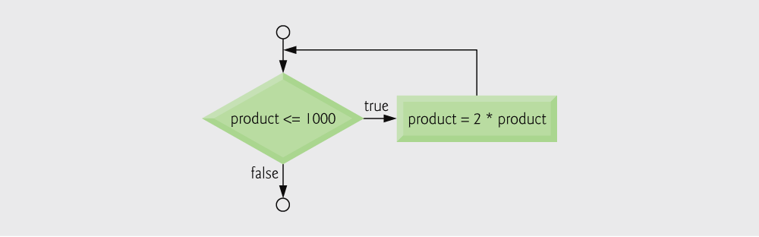
Fig. 3.4 | Flowcharting the while repetition statement.

Slide 35
3.8 Counter-Controlled Repetition
Counter-controlled repetition
  Loop repeated until counter reaches a certain value
  Definite repetition: number of repetitions is known
  Example: A class of ten students took a quiz. The grades (integers in the range 0 to 100) for this quiz are available to you. Determine the class average on the quiz.

Slide 36
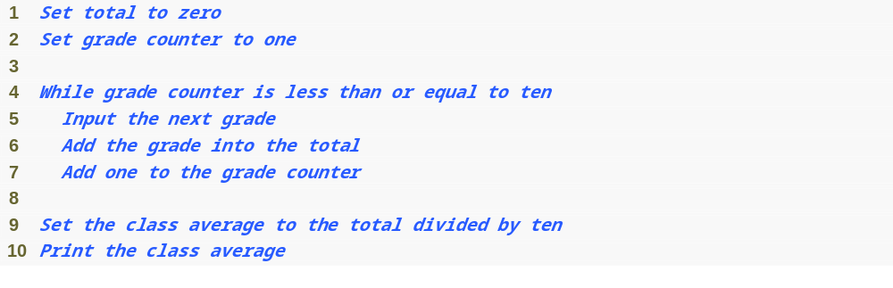
Fig. 3.5 | Pseudocode algorithm that uses counter-controlled repetition to
solve the class average problem.

Slide 37
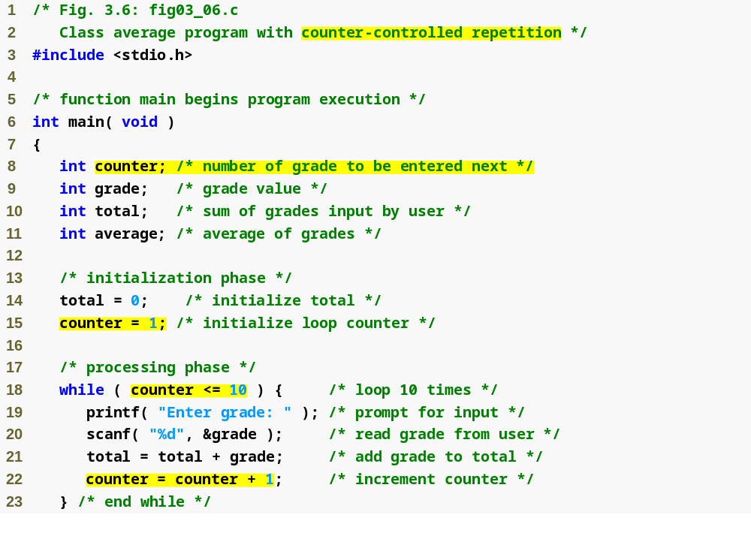
Outline
fig03_06.c
(1 of 2 )
Counter to control while loop
Initialize counter to 1
while loop iterates as long as counter <= 10
Increment the counter

Slide 38
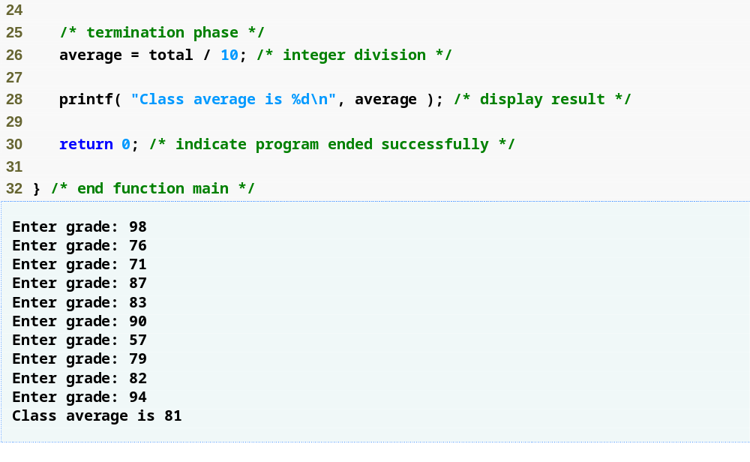
Outline
Calculate the average
fig03_06.c
(2 of 2 )

Slide 39
Common Programming Error 3.5
If a counter or total is not initialized, the results of your program will probably be incorrect. This is an example of a logic error.

Slide 40
Error-Prevention Tip 3.2
Initialize all counters and totals.

Slide 41
3.9 Formulating Algorithms with Top-Down, Stepwise Refinement
Problem becomes:
  Develop a class-averaging program that will process an arbitrary number of grades each time the program is run.
  Unknown number of students
  How will the program know to end?
Use sentinel value
  Also called signal value, dummy value, or flag value
  Indicates “end of data entry.”
  Loop ends when user inputs the sentinel value
  Sentinel value chosen so it cannot be confused with a regular input (such as -1 in this case)

Slide 42
Common Programming Error 3.6
Choosing a sentinel value that is also a legitimate data value.

Slide 43
3.9 Formulating Algorithms with Top-Down, Stepwise Refinement
Top-down, stepwise refinement
  Begin with a pseudocode representation of the top:
    Determine the class average for the quiz
  Divide top into smaller tasks and list them in order:
    Initialize variables
    Input, sum and count the quiz grades
    Calculate and print the class average
Many programs have three phases:
  Initialization: initializes the program variables
  Processing: inputs data values and adjusts program variables accordingly
  Termination: calculates and prints the final results

Slide 44
Software Engineering Observation 3.3
Each refinement, as well as the top itself, is a complete specification of the algorithm; only the level of detail varies.

Slide 45
3.9 Formulating Algorithms with Top-Down, Stepwise Refinement
Refine the initialization phase from Initialize variables to:
    Initialize total to zero
    Initialize counter to zero
Refine Input, sum and count the quiz grades to
    Input the first grade (possibly the sentinel)
    While the user has not as yet entered the sentinel
    Add this grade into the running total
    Add one to the grade counter
    Input the next grade (possibly the sentinel)

Slide 46
3.9 Formulating Algorithms with Top-Down, Stepwise Refinement
Refine Calculate and print the class average to
    If the counter is not equal to zero
    Set the average to the total divided by the counter
    Print the average
    else
    Print “No grades were entered”

Slide 47
Common Programming Error 3.7
An attempt to divide by zero causes a fatal error.

Slide 48
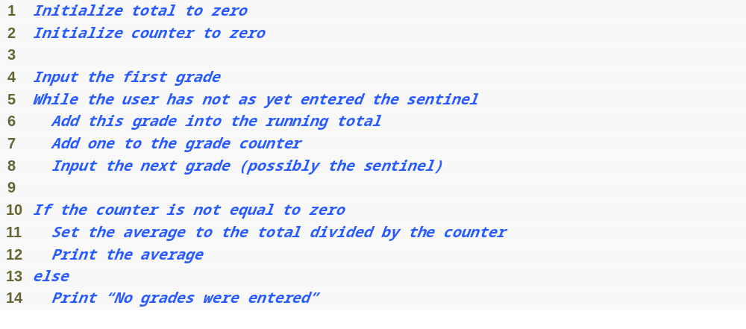
Fig. 3.7 | Pseudocode algorithm that uses sentinel-controlled repetition to
solve the class average problem.

Slide 49
Good Programming Practice 3.5
When performing division by an expression whose value could be zero, explicitly test for this case and handle it appropriately in your program (such as printing an error message) rather than allowing the fatal error to occur.

Slide 50
Software Engineering Observation 3.4
Many programs can be divided logically into three phases: an initialization phase that initializes the program variables; a processing phase that inputs data values and adjusts program variables accordingly; and a termination phase that calculates and prints the final results.

Slide 51
Software Engineering Observation 3.5
You terminate the top-down, stepwise refinement process when the pseudocode algorithm is specified in sufficient detail for you to be able to convert the pseudocode to C. Implementing the C program is then normally straightforward.

Slide 52
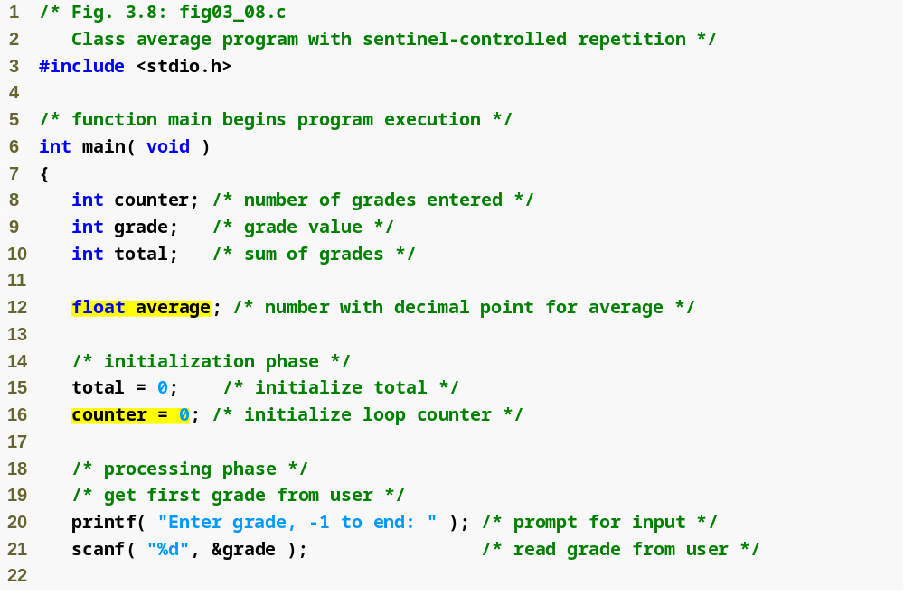
Outline
fig03_08.c
(1 of 3 )
float type indicates variable can be a non-integer

Slide 53
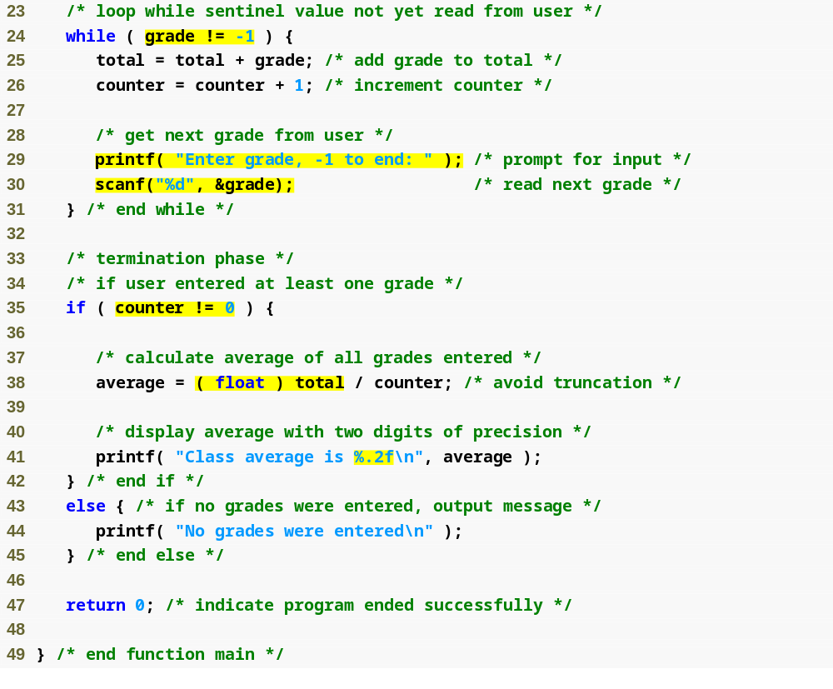
Outline
while loop repeats until user enters a value of -1
fig03_08.c
(2 of 3 )
Ensures the user entered at least one grade
Converts total to float type
Prints result with 2 digits after decimal point

Slide 54
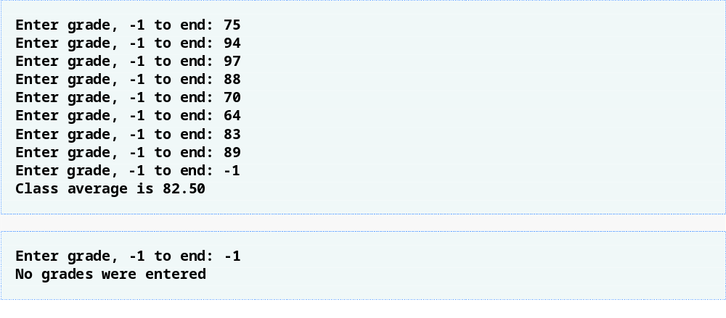
Outline
fig03_08.c
(3 of 3 )

Slide 55
Good Programming Practice 3.6
In a sentinel-controlled loop, the prompts requesting data entry should explicitly remind the user what the sentinel value is.

Slide 56
Common Programming Error 3.8
Using precision in a conversion specification in the format control string of a scanf statement is wrong. Precisions are used only in printf conversion specifications.

Slide 57
Common Programming Error 3.9
Using floating-point numbers in a manner that assumes they are represented precisely can lead to incorrect results. Floating-point numbers are represented only approximately by most computers.

Slide 58
Error-Prevention Tip 3.3
Do not compare floating-point values for equality.

Slide 59
3.10 Nested Control Structures
Problem
  A college has a list of test results (1 = pass, 2 = fail) for 10 students
  Write a program that analyzes the results
    If more than 8 students pass, print "Raise Tuition"
Notice that
  The program must process 10 test results
    Counter-controlled loop will be used
  Two counters can be used
    One for number of passes, one for number of fails
  Each test result is a number—either a 1 or a 2
    If the number is not a 1, we assume that it is a 2

Slide 60
3.10 Nested Control Structures
Top level outline
    Analyze exam results and decide if tuition should be raised
First Refinement
    Initialize variables
    Input the ten quiz grades and count passes and failures
    Print a summary of the exam results and decide if tuition should be raised
Refine Initialize variables to
    Initialize passes to zero
    Initialize failures to zero
    Initialize student counter to one

Slide 61
3.10 Nested Control Structures
Refine Input the ten quiz grades and count passes and failures to
    While student counter is less than or equal to ten
    Input the next exam result
    If the student passed
    Add one to passes
    else
    Add one to failures
    Add one to student counter
Refine Print a summary of the exam results and decide if tuition should be raised to
    Print the number of passes
    Print the number of failures
    If more than eight students passed
    Print “Raise tuition”

Slide 62
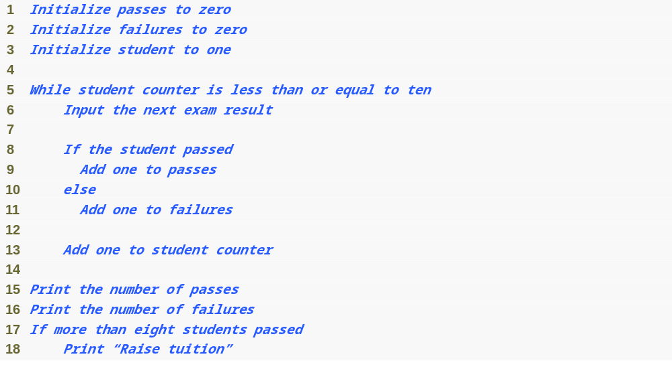
Fig. 3.9 | Pseudocode for examination results problem.

Slide 63
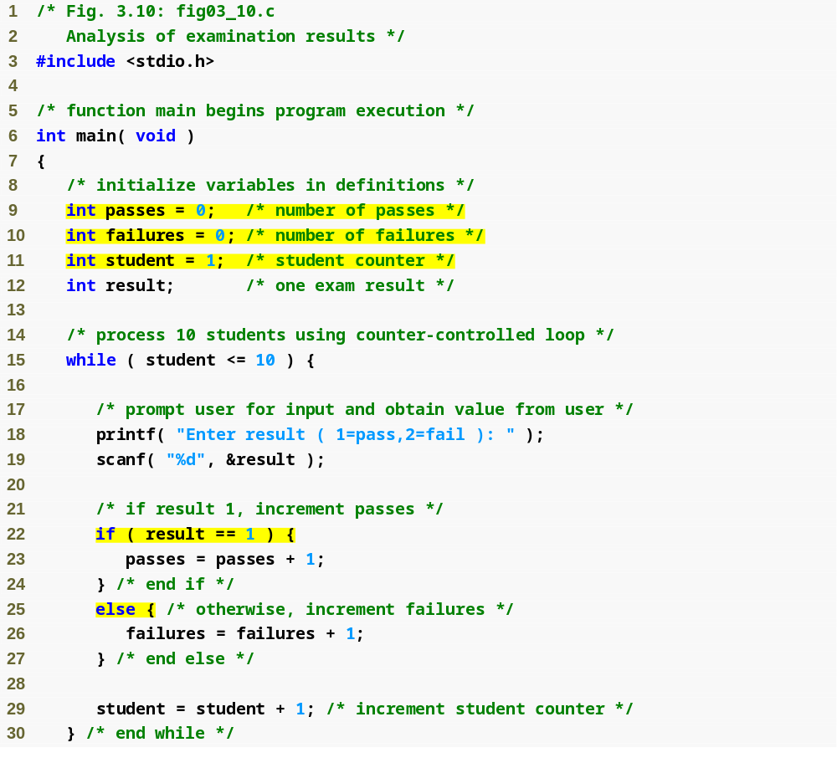
Outline
fig03_10.c
(1 of 3 )
while loop continues until 10 students have been processed
if and else statements are nested inside while loop

Slide 64
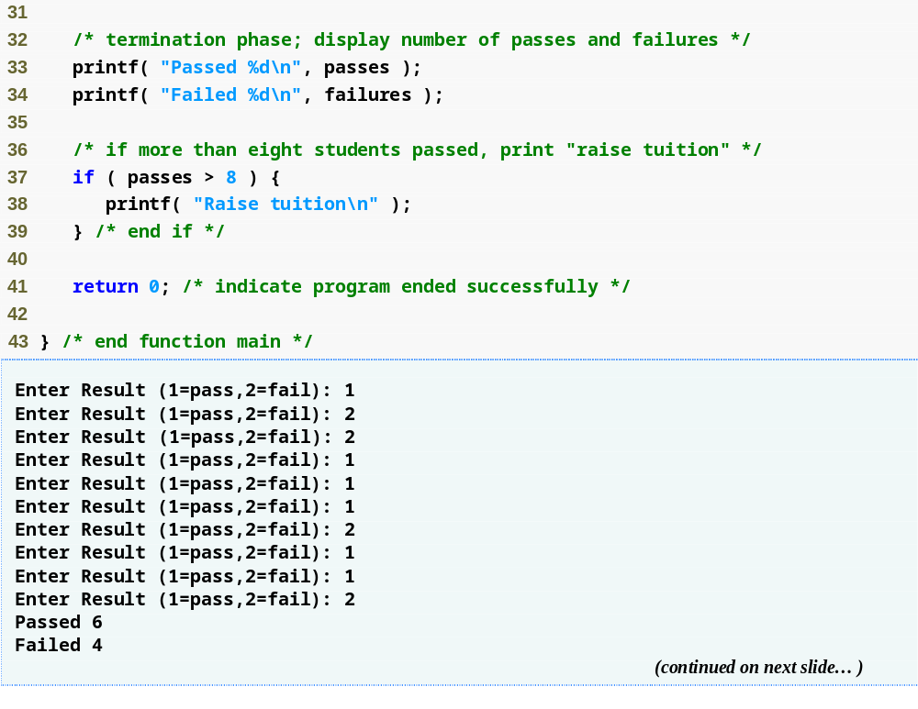
Outline
fig03_10.c
(2 of 3 )

Slide 65
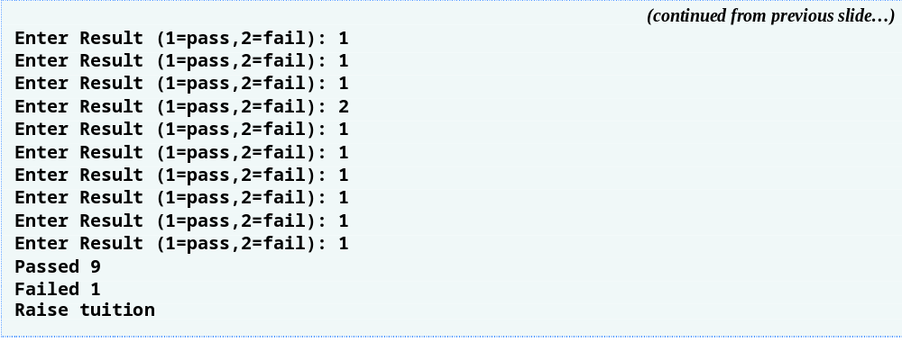
Outline
fig03_10.c
(3 of 3 )

Slide 66
Performance Tip 3.1
Initializing variables when they are defined can help reduce a program’s execution time.

Slide 67
Performance Tip 3.2
Many of the performance tips we mention in this text result in nominal improvements, so the reader may be tempted to ignore them. Note that the cumulative effect of all these performance enhancements can make a program perform significantly faster. Also, significant improvement is realized when a supposedly nominal improvement is placed in a loop that may repeat a large number of times.

Slide 68
Software Engineering Observation 3.6
Experience has shown that the most difficult part of solving a problem on a computer is developing the algorithm for the solution. Once a correct algorithm has been specified, the process of producing a working C program is normally straightforward.

Slide 69
Software Engineering Observation 3.7
Many programmers write programs without ever using program development tools such as pseudocode. They feel that their ultimate goal is to solve the problem on a computer and that writing pseudocode merely delays the production of final outputs.

Slide 70
3.11 Assignment Operators
Assignment operators abbreviate assignment expressions
    c = c + 3;
  can be abbreviated as c += 3; using the addition assignment operator
Statements of the form
    variable = variable operator expression;
  can be rewritten as
    variable operator= expression;
Examples of other assignment operators:
    d -= 4 (d = d - 4)
    e *= 5 (e = e * 5)
    f /= 3 (f = f / 3)
    g %= 9 (g = g % 9)

Slide 71
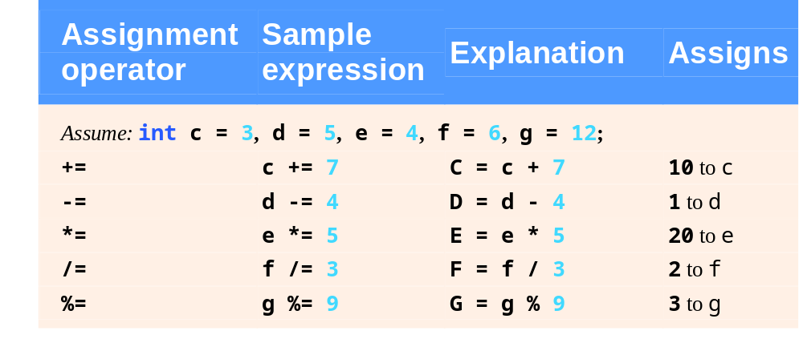
Fig. 3.11 | Arithmetic assignment operators.

Slide 72
3.12 Increment and Decrement Operators
Increment operator (++)
  Can be used instead of c+=1
Decrement operator (--)
  Can be used instead of c-=1
Preincrement
  Operator is used before the variable (++c or --c)
  Variable is changed before the expression it is in is evaluated
Postincrement
  Operator is used after the variable (c++ or c--)
  Expression executes before the variable is changed

Slide 73
3.12 Increment and Decrement Operators
If c equals 5, then
    printf( "%d", ++c );
  Prints 6
    printf( "%d", c++ );
  Prints 5
  In either case, c now has the value of 6
When variable not in an expression
  Preincrementing and postincrementing have the same effect
    ++c;
    printf( “%d”, c );
  Has the same effect as
    c++;
    printf( “%d”, c );

Slide 74
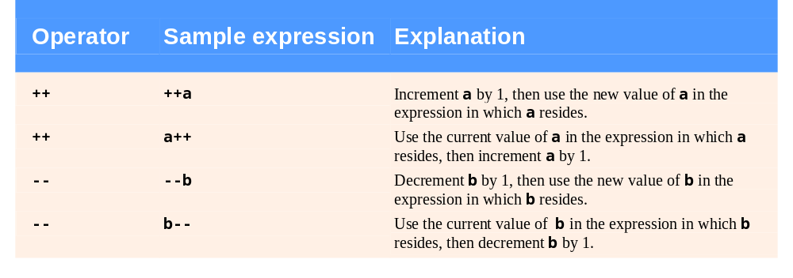
Fig. 3.12 | Increment and decrement operators.

Slide 75
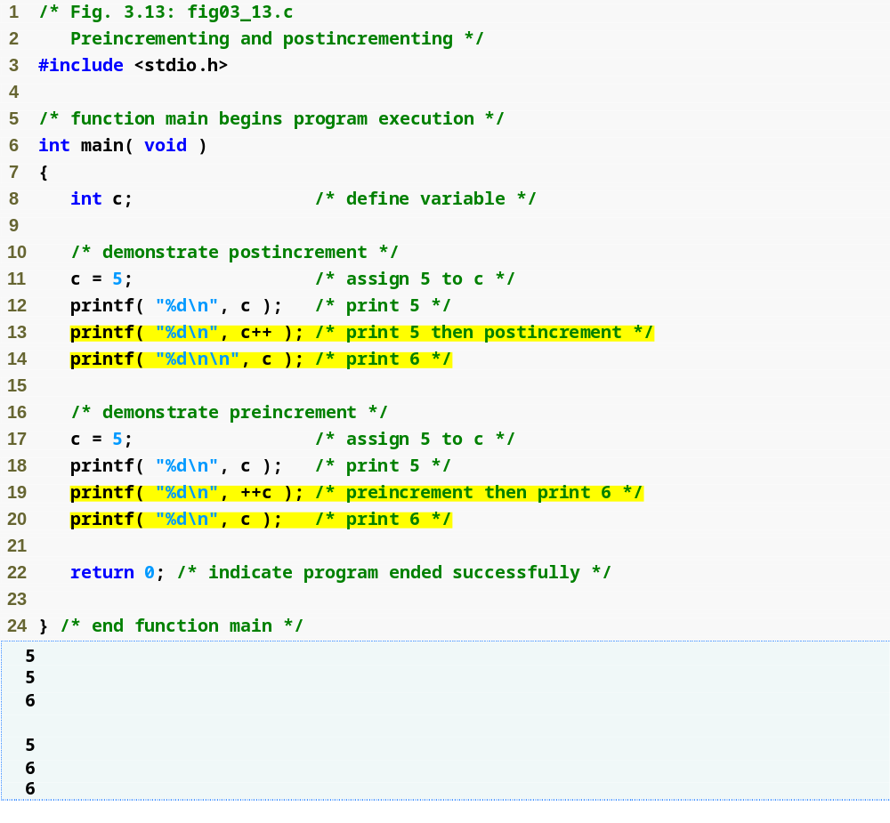
Outline
fig03_13.c
c is printed, then incremented
c is incremented, then printed

Slide 76
Good Programming Practice 3.7
Unary operators should be placed directly next to their operands with no intervening spaces.

Slide 77
Common Programming Error 3.10
Attempting to use the increment or decrement operator on an expression other than a simple variable name is a syntax error, e.g., writing ++(x + 1).

Slide 78
Error-Prevention Tip 3.4
C generally does not specify the order in which an operator’s operands will be evaluated (although we will see exceptions to this for a few operators in Chapter 4). Therefore you should avoid using statements with increment or decrement operators in which a particular variable being incremented or decremented appears more than once.

Slide 79
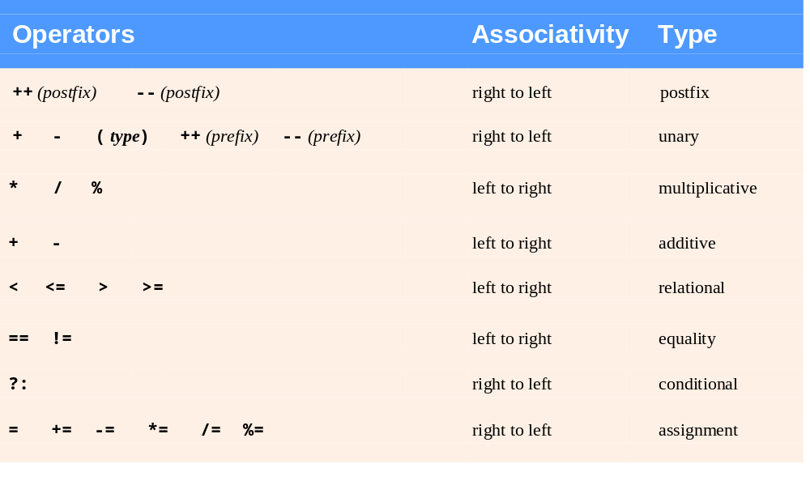
Fig. 3.14 | Precedence of the operators encountered so far in the text.

